Slide 1
A ROBUST APPROACH FOR IMPROVING THE ACCURACY OF IMU BASED LOCALISATION
Group No: 50 Date: 18/05/2016
Team Members
Project Advisor (Guide) : Dr. Vidhya Balasubramanian
S.No | Reg.No | Name | Section
1 | CB.EN.U4CSE12123 | Kiran Kassyap S | CSE-B
2 | CB.EN.U4CSE12144 | Srivenkata Krishnan | CSE-B
3 | CB.EN.U4CSE12147 | Sundarrajan G | CSE-B

Slide 2
A ROBUST APPROACH FOR IMPROVING THE ACCURACY OF IMU BASED LOCALISATION

Slide 3
PROBLEM STATEMENT
To develop an error reducing algorithm for Indoor localization of mobile robots using
the inertial measurement units(IMUs) and
Range finder sensors.

Slide 4
Introduction

Slide 5
Robotic Indoor Localization
Robotic Indoor Localization:
It is method in which the position and orientation of the mobile robot is determined with respect to the indoor environment
They are essential for any Autonomous mobile robot for smooth navigation.

Slide 6
Hybrid Approach
The use of dead reckoning approach to solve the problem of robotic indoor localization with the help of the inertial measurement unit (IMU) and Obstacle avoidance system.
We obtain position and orientation estimates from three different methods:
Encoders
Gyroscope
Obstacle avoidance system

Slide 7
Applications
Can be used as assistive robots in emergency situations which can be hazardous for people
Object tracking with RFID based approaches

Slide 8
Design and
Architecture

Slide 9
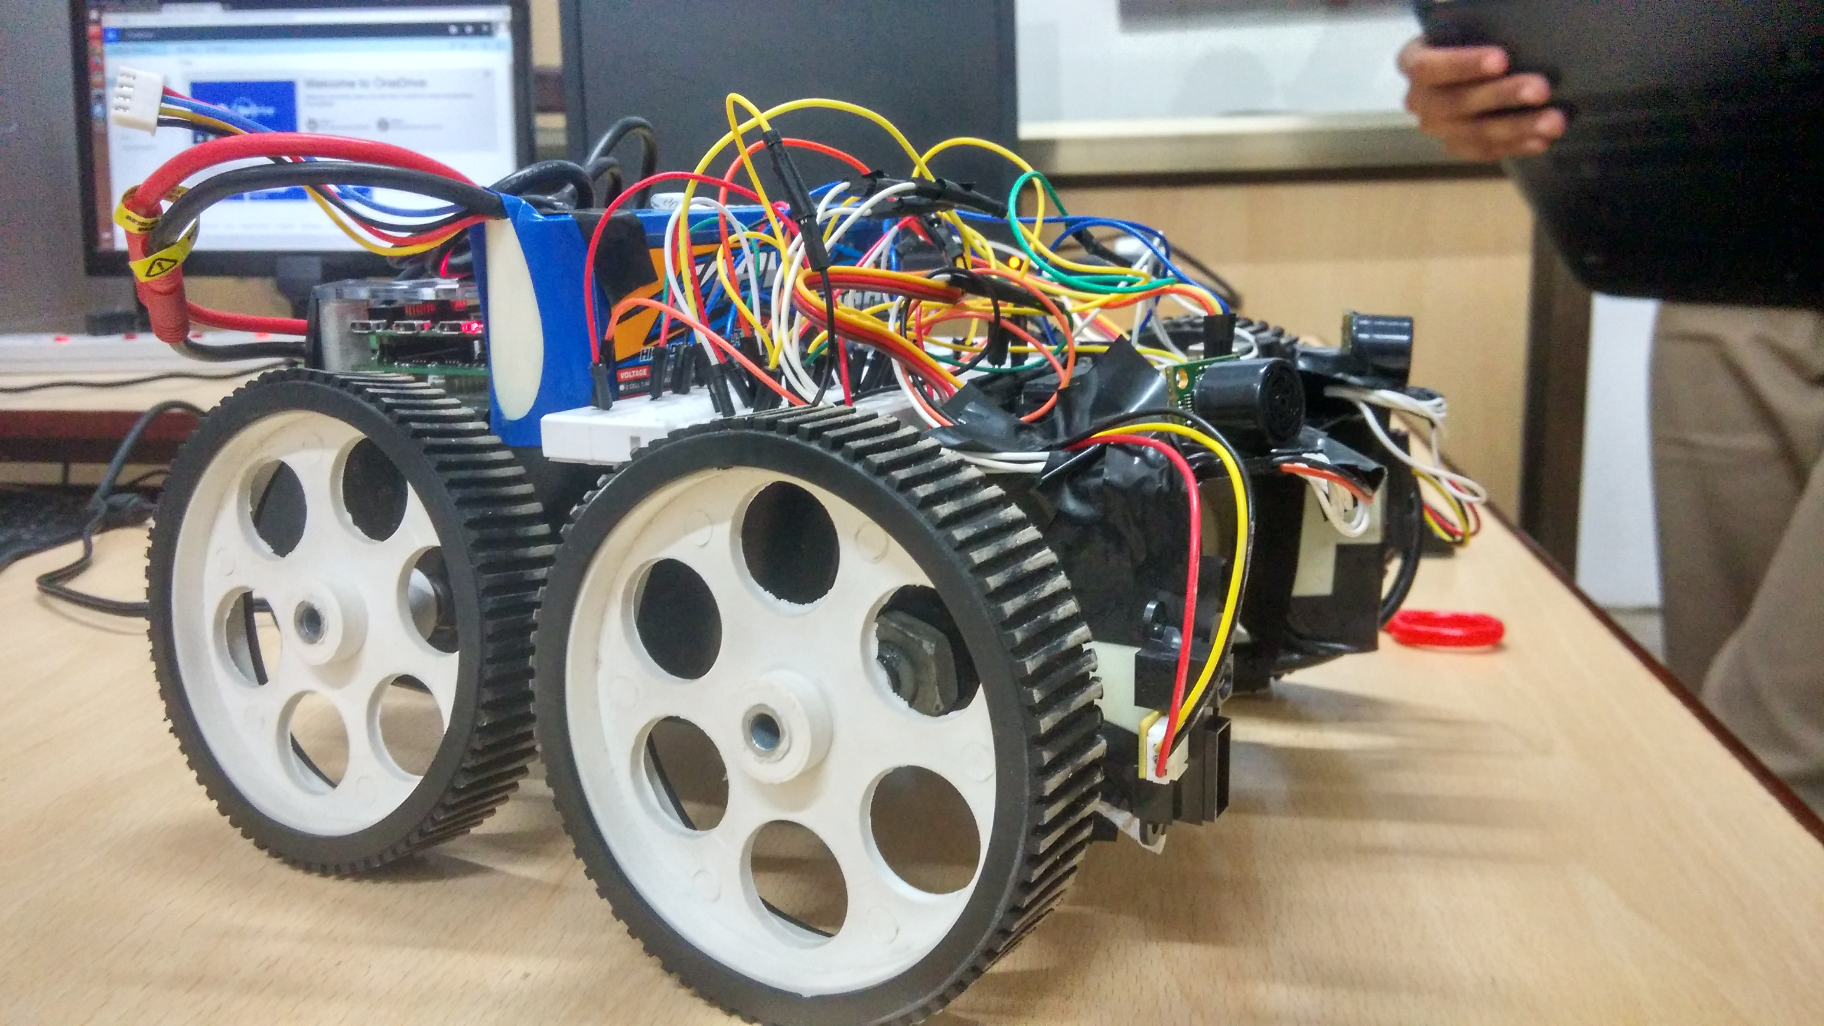
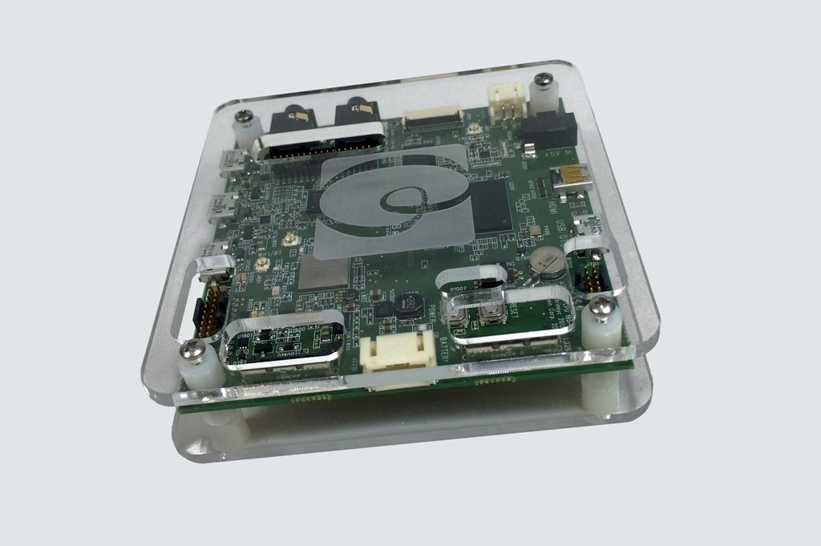
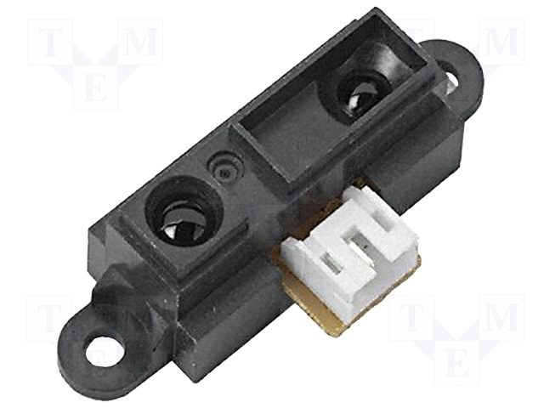
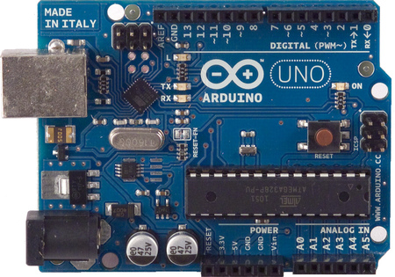
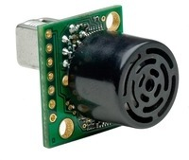
Design
Design of our robot
Components used

Slide 10
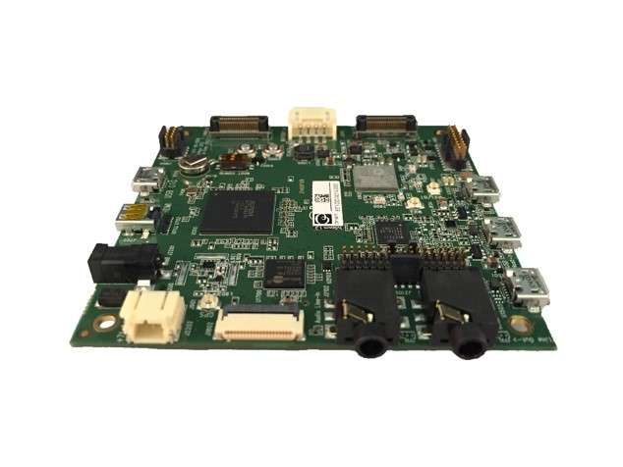
Hardware Specifications
Bstem and Adcord board
Arduino microcontroller
IMU’S – Gyroscope
Stepper motors and motor encoders.
Zippy 5000mah Li-Polymer battery
Robot Chassis and Wheels
Range finder sensors

Slide 11
Software Specifications
Operating System - Ubuntu
Environment - Python
Plot library - Bstem plotter
SSH protocol is used to establish connection with the robot through Wi-Fi.

Slide 12
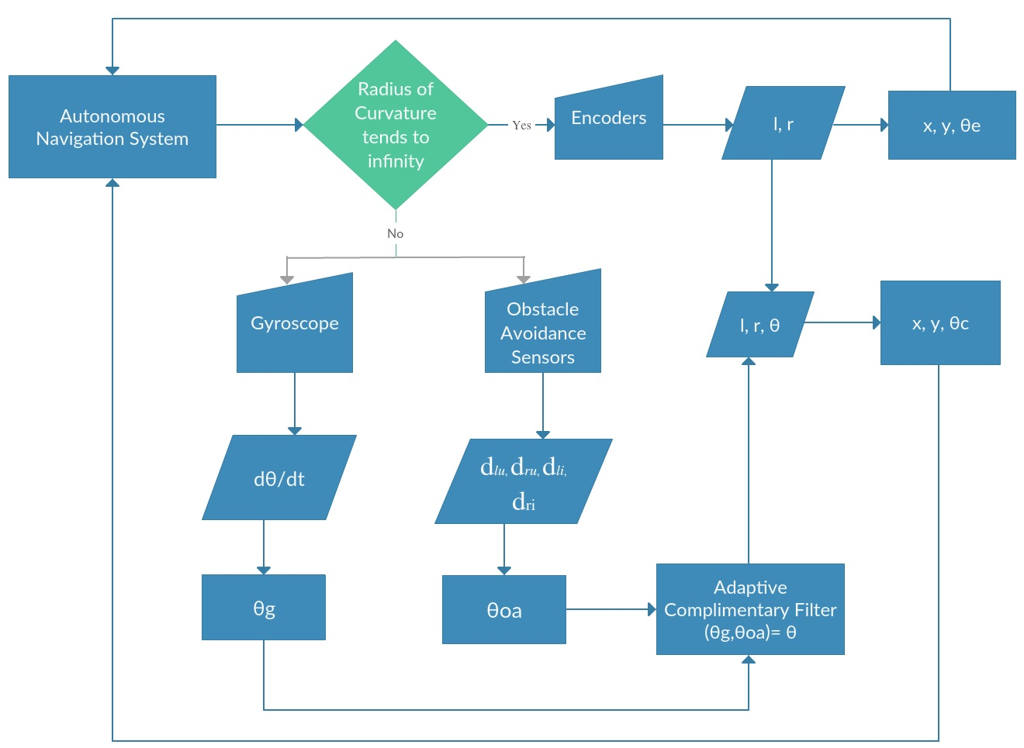
Architecture Diagram

Slide 13
Position Integration
We make use of the motor encoders to calculate the distance travelled and orientation of the robot.
With help of Complementary filter we integrate orientations obtained from gyroscope and obstacle avoidance system
By the Curvature decision algorithm we determine which position and orientation to be used according to the current scenario.

Slide 14
Encoders

Slide 15
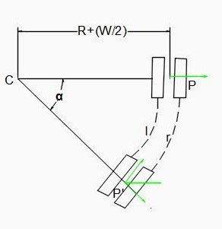

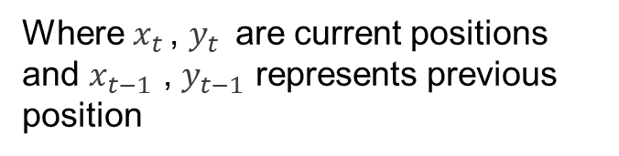
Encoder Position Estimation
$$x_{t }=x_{t−1}+l\cos{Ɵ_{t}}$$
$y_{t }=y_{t−1}+l\sin{Ɵ_{t}}$
Where $x_{t }$, $y_{t }$ are current positions and $x_{t−1}$ , $y_{t−1}$ represents previous position

Slide 16
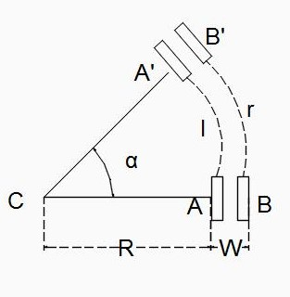
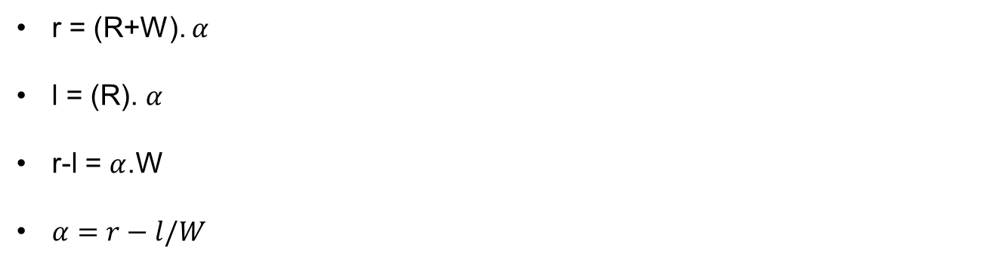
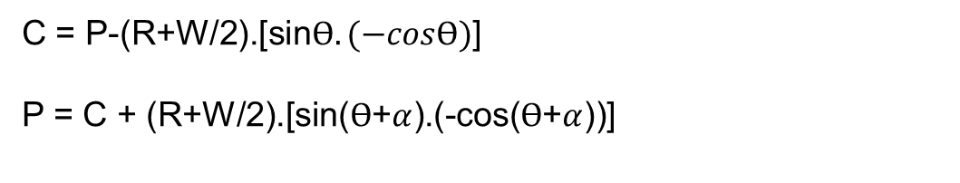
Encoder Orientation Estimation
r = (R+W). $α$
l = (R). $α$
r-l = $α$.W
$α=r−l/W$
C = P-(R+W/2).[sin$Ɵ.(−cosƟ)$]
P = C + (R+W/2).[sin($Ɵ$+$α$).(-cos($Ɵ$+$α$))]
r = Right ticks
l = left ticks
W = Width

Slide 17
Gyroscope

Slide 18
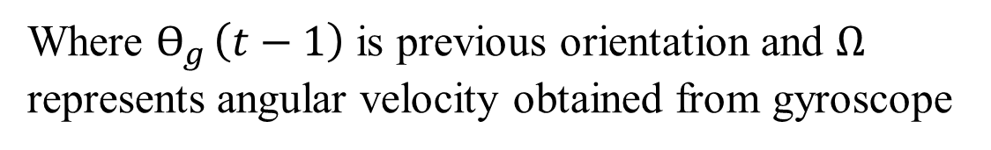
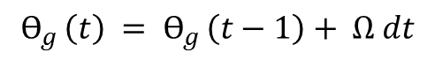
Gyroscope Orientation
Orientation of the robot can be accurately measured using the formula,
$$Ɵ_{g }\left(t\right) = Ɵ_{g }\left(t−1\right)+ Ω dt$$
Where $Ɵ_{g }\left(t−1\right)$ is previous orientation and $Ω$ represents angular velocity obtained from gyroscope

Slide 19
Obstacle Avoidance

Slide 20
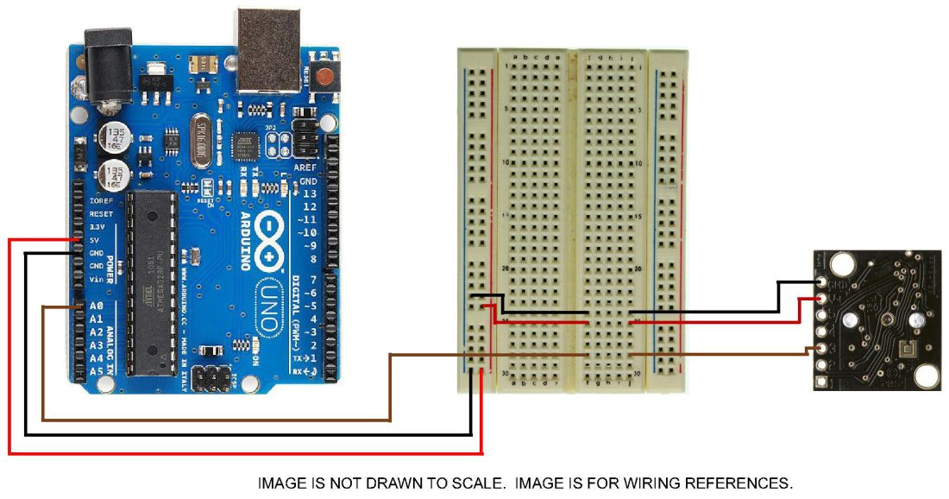
Circuit diagram
Ultrasonic Sensor : (For detection greater than 30cms)

Slide 21
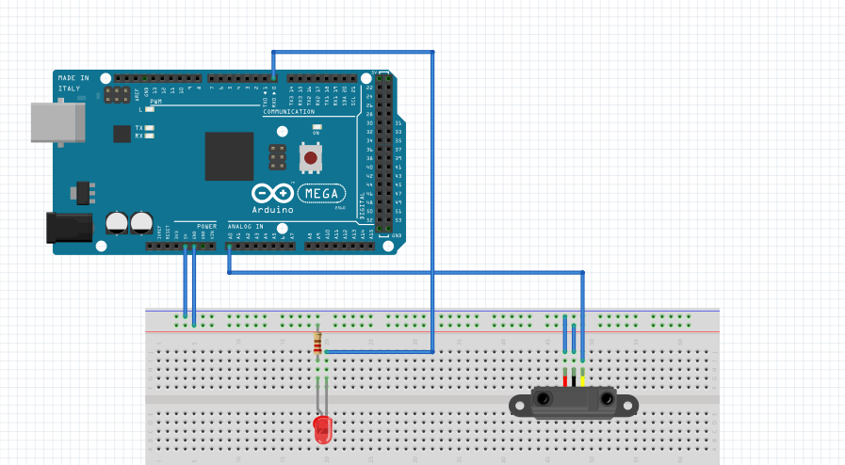
Circuit diagram (contd)
Infrared Sensor : (For detection less than 30cms)

Slide 22
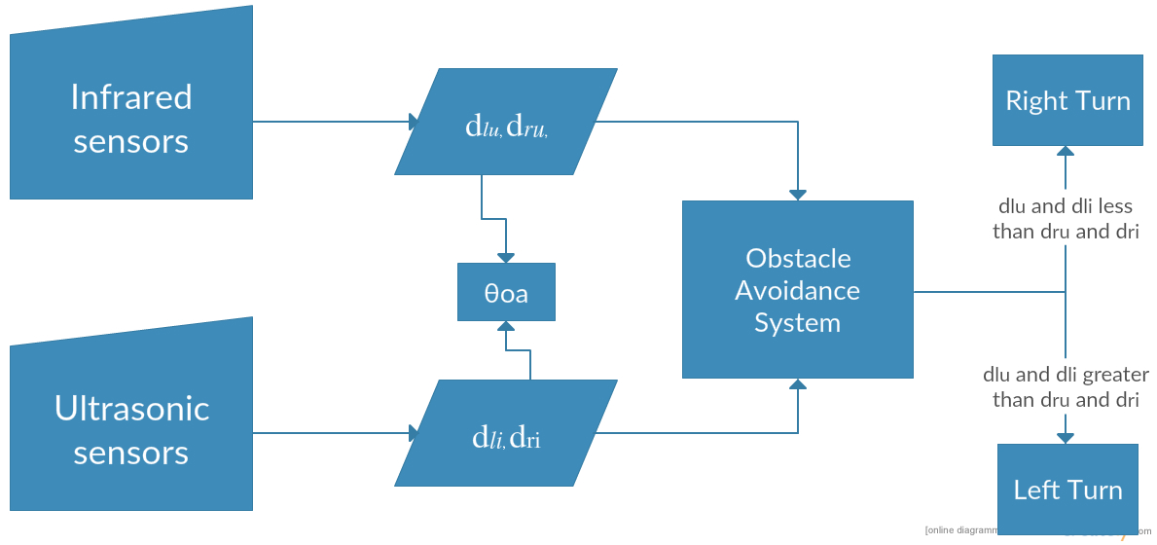
Obstacle Avoidance Design

Slide 23
Obstacle Avoidance
Obstacle avoidance is done with help of distance from both ultrasonic and infrared sensors
If the distance is less than Dsafe then the bot is programmed to avoid obstacles
Ultrasonic sensors are used for determining obstacles above 30cm and Infrared sensors are used for detecting obstacles less than 30cm

Slide 24
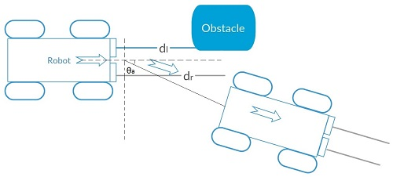
Obstacle Avoidance

Slide 25
Orientation Estimate for Avoiding Obstacle
Right turn:
θoa(t) = θoa(t −1)− n×(π/2)(kθ/dr)
Left turn:
θoa(t) = θoa(t −1)+ n×(π/2)(kθ/dl)

Slide 26
EXPERIMENTS UNDERTAKEN
SQUARE TRAJECTORY
EIGHT TRAJECTORY
RANDOM TRAJECTORY

Slide 27
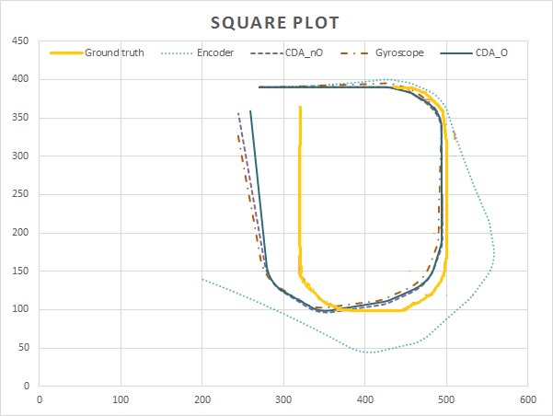
SQUARE TRAJECTORY

Slide 28
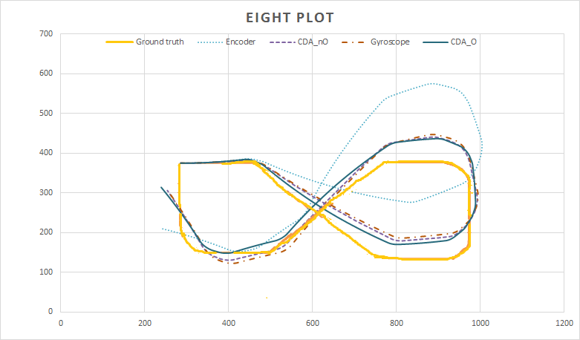
EIGHT TRAJECTORY

Slide 29
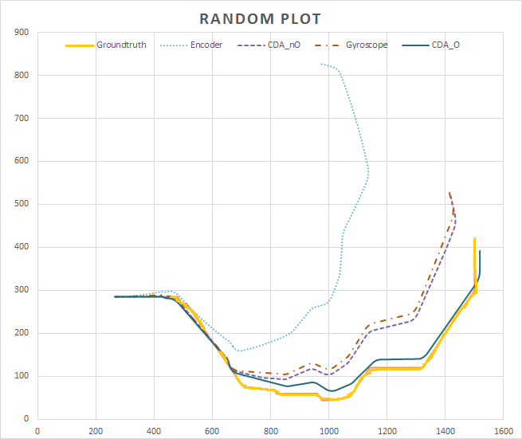
RANDOM TRAJECTORY

Slide 30
AVERAGE EUCLIDEAN ERROR
Methods implemented | Trajectory 1 (Square) (cm) | Trajectory 2 (Eight) (cm) | Trajectory 3 (Random) (cm)
Encoders | 121.96 | 89.27 | 333.65
Gyroscope | 40.50 | 44.22 | 75.33
CDA_nO | 28.64 | 39.50 | 65.38
CDA_O | 20.25 | 34.68 | 20.49

Slide 31
CONCLUSION
Our experiments have shown that by using only gyroscopes as and when needed, the drift errors are reduced considerably.
By employing the additional data from obstacle avoidance sensors, we see that the accuracy is improved multifold.

Slide 32
REFERENCE PAPERS

Slide 33
Reference Papers
(2015), bStem developer kit integrated robotics platform: http://www.braincorporation.com.
2. Ahn, H.-S. and Yu, W. (2007). ”Indoor mobile robot and pedestrian localization techniques”. In Control, Automation and Systems, 2007. ICCAS’07. International Conference on, pages 2350–2354. IEEE.
3. Borenstein, J. and Feng, L. (1994). Umbmark: “a method for measuring, comparing, and correcting dead-reckoning errors in mobile robots”. WP6, March 27, 1995. The University of Michigan.

Slide 34
Reference Papers
4. Choi, B.-S., Lee, J.-W., Lee, J.-J., and Park, K.-T. (2011). “A hierarchical algorithm for indoor mobile robot localization using RFID sensor fusion”. Industrial Electronics, IEEE Transactions on, 58(6):2226–2235.
5. DeSouza, G. N. and Kak, A. C. (2002). “Vision for mobile robot navigation: A survey. Pattern Analysis and Machine Intelligence”, IEEE Transactions on, 24(2):237–267.
6. Easton, A. and Cameron, S. (2006). “A gaussian error model for triangulation-based pose estimation using noisy landmarks”. In Robotics, Automation and Mechatronics, 2006 IEEE Conference on, pages 1–6. IEEE.

Slide 35
Reference Papers
7. Arduino uno,https://www.arduino.cc/en/main/arduinoBoardUno
8. Appearance-based navigation, localization, mapping, and map merging for heterogeneous teams of robots.”, UC Merced Electronic Theses and Dissertations ,2013
9. Granados-Cruz, M., Pomarico-Franquiz, J., Shmaliy, Y. S., and Morales-Mendoza, L. J. (2014).” Triangulationbased indoor robot localization using extended kalman filtering”. In Electrical Engineering, Computing Science and Automatic Control (CCE), 2014 11th International Conference on, pages 1–5. IEEE.

Slide 36
Reference Papers
10. Ibrahim Zunaidi, Norihiko Kato, Y. N. and Matsui, H. (2006). “Positioning system for 4wheel mobile robot: Encoder, gyro and accelerometer data fusion with error model method”. In CMU Journal, volume 5.
11. Jensfelt, P. (2001). “Approaches to mobile robot localization in indoor environments”. Citeseer. Master’s thesis, School of Informatics, University of Edinburgh
12. Kam, M., Zhu, X., and Kalata, P. (1997). “Sensor fusion for mobile robot navigation. Proceedings of the IEEE, 85(1):108–119.
13. Kelley, K. J. (2015). “Wi-fi location determination for semantic locations. The Hilltop Review”, 7(1):9.

Slide 37
Reference Papers
14. Li, J. (2012). “Characterization of wlan location fingerprinting systems. Master’s thesis”, School of Informatics, University of Edinburgh. Liu, H.,
15. Darabi, H., Banerjee, P., and Liu, J. (2007). “Survey of wireless indoor positioning techniques and systems”. Systems, Man, and Cybernetics, Part C: Applications and Reviews, IEEE Transactions on, 37(6):1067–1080.
16. Surmann, H., Nuchter, A., and Hertzberg, J. (2003). “An autonomous mobile robot with a 3d laser range finder for 3d exploration and digitalization of indoor environments”. Robotics and Autonomous Systems, 45(3):181–198.
17. Widodo Budiharto, D. P. and Jazidie, A. (2011). “A robust obstacle avoidance for service robot using Bayesian approach”. International Journal of Advanced Robotic Systems, 8:52–60.

Slide 38
Reference Papers
18. Xiao, Z., Wen, H., Markham, A., and Trigoni, N. (2014). “Lightweight map matching for indoor localisation using conditional random fields. In Information Processing in Sensor Networks”, IPSN-14 Proceedings of the 13th International Symposium on, pages 131–142.
19. Zhang, H., Chen, J. C., and Zhang, K. (2014).” Rfid-based localization system for mobile robot with markov chain monte carlo”. In American Society for Engineering Education (ASEE Zone 1), 2014 Zone 1 Conference of the, pages 1–6. IEEE

